Slide 1
Binary Search Tree
(BST)
Created by : Sankait Gupta
Assistant Professor
Deptt. Of Computer Applications
Govt P.G.College Rajouri

Slide 2
DEFINITION
A Binary Tree is called a Binary Search Tree if a node with data element has the following characteristics :
Each node with data element in left subtree is less than its root element.
Each node with data element in right subtree is greater than or equal to its root element.
Both left subtree and right subtree will be again the Binary Search Trees.

Slide 3
Some Important Terms
The successor nodes of a node are called its children
The predecessor node of a node is called its parent
The “first" node is called the root (has no parent)
A node (at last level) without children is called a leaf or terminal node

Slide 4
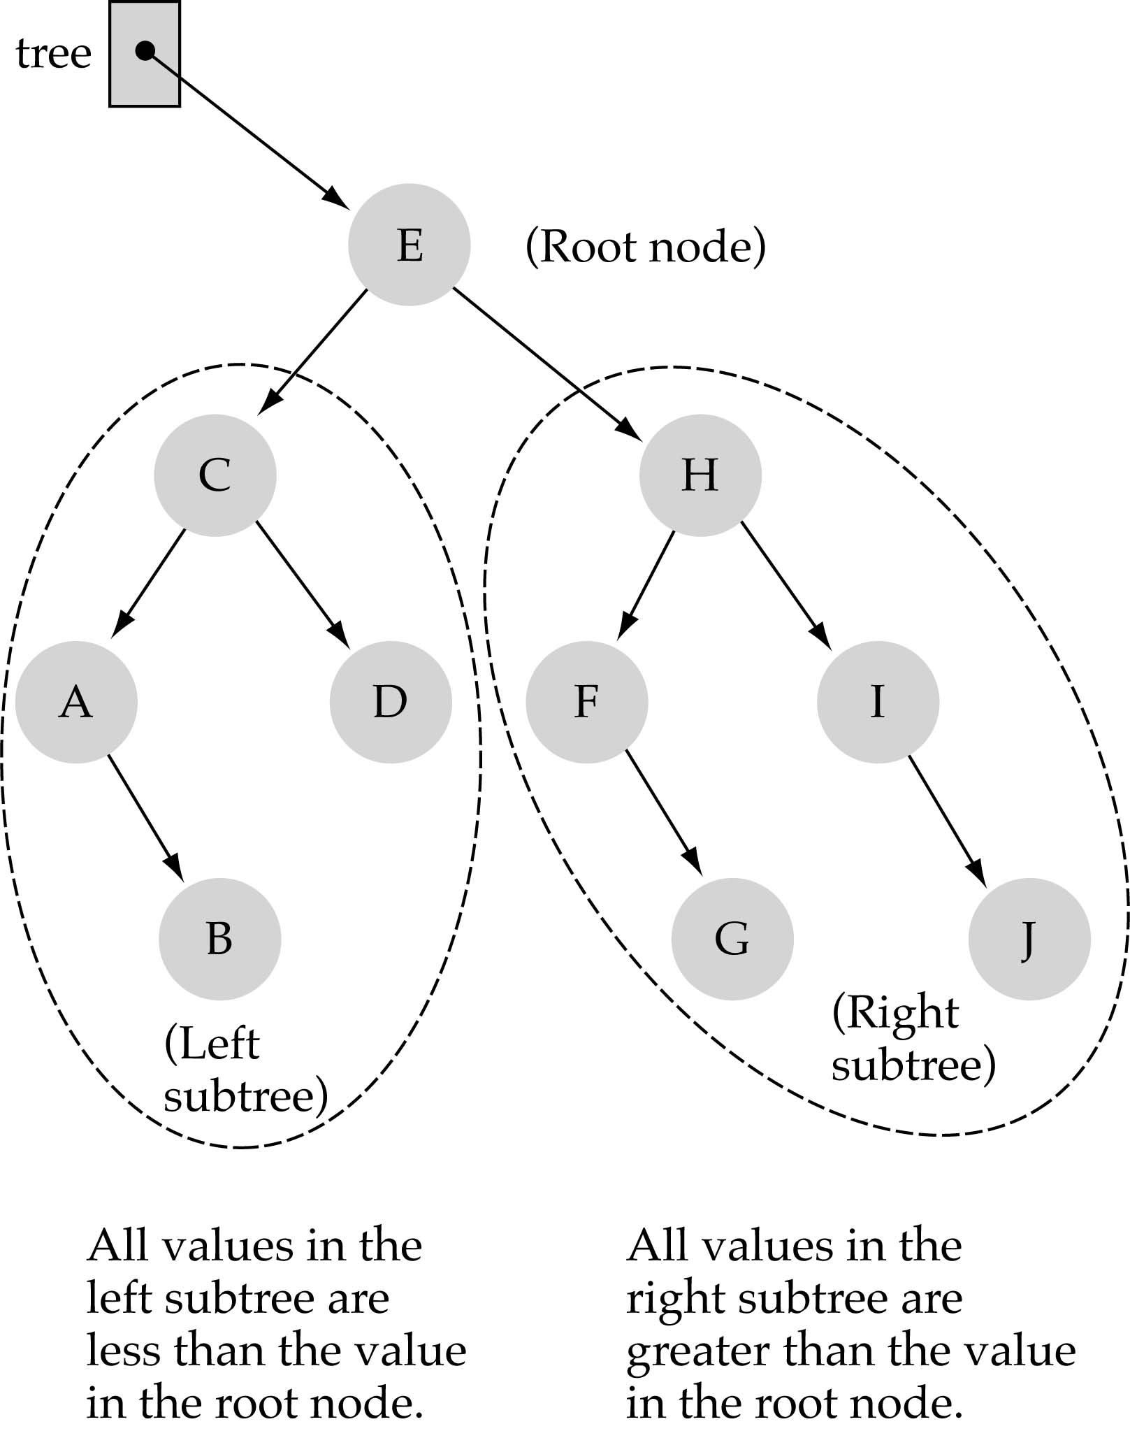
REPRESENTATION OF BST
Following is a pictorial representation of BST −

Slide 5
As it is clear from the example that the root node E has all the less values on the left subtree and the higher values on the right subtree.
The value stored at a node is greater than the value stored at its left child and less than the value stored at its right child.
BST,

Slide 6
OPERATIONS ON BST
Traversal
Searching
Insertion
Deletion
Finding Largest element
Finding smallest element

Slide 7
SEARCHING IN BST
(1) Start at the root
(2) Compare the value of the item you are searching for with the value stored at the root
(3) If the values are equal, then item found; otherwise, if it is a leaf node, then not found

Slide 8
(4) If it is less than the value stored at the root, then search the left subtree
(5) If it is greater than the value stored at the root, then search the right subtree
(6) Repeat steps 2-6 for the root of the subtree chosen in the previous step 4 or 5

Slide 9
COMPARISON
Complexity of BST Searching
O(logN)
Complexity of Linked List Searching
O(N)
So it is clear that the BST searching is better one.

Slide 10
BST SEARCH ALGORITHM
Suppose we have a Tree with ROOT and ITEM is the number to be searched.
BSTSearch(ROOT,ITEM,POSITION,PARENT)
Steps involved in the algorithm :
Step 1: If ROOT=NULL, then
set Position=NULL and
set PARENT=NULL
EXIT
[End if]

Slide 11
Step 2: Set Pointer=ROOT and PointerP=NULL
Step 3: Repeat step 4 while Pointer!=NULL
Step 4: If item=Pointer -> info , then
set POSITION=Pointer and
set PARENT=PointerP
Exit

Slide 12
Else if item < Pointer -> info , then
set PointerP=Pointer and
set Pointer=Pointer -> left
else
set PointerP=Pointer and
set Pointer=Pointer -> right
[End if]
[End of loop]

Slide 13
Step 5: Set Position=NULL and
PARENT=NULL
Step 6: Exit.

Slide 14
Thank You..............

